Slide 1


Viva Connections Extensibility Overview
Microsoft EXP Connections
Notes:
November 2019

Slide 2

Today’s Topics
Viva Connections Dashboard
What kind of experiences
Extensibility capabilities

Slide 3
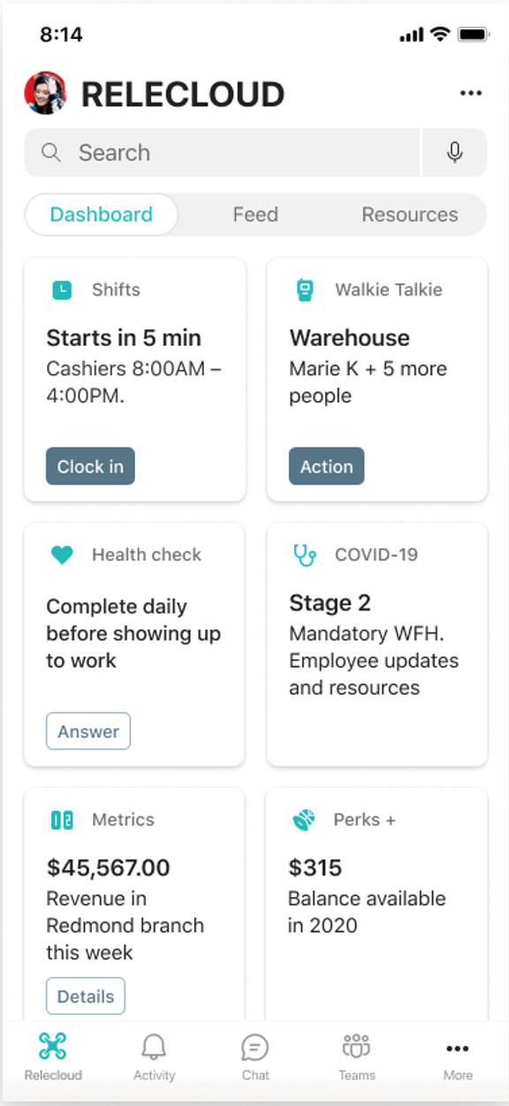
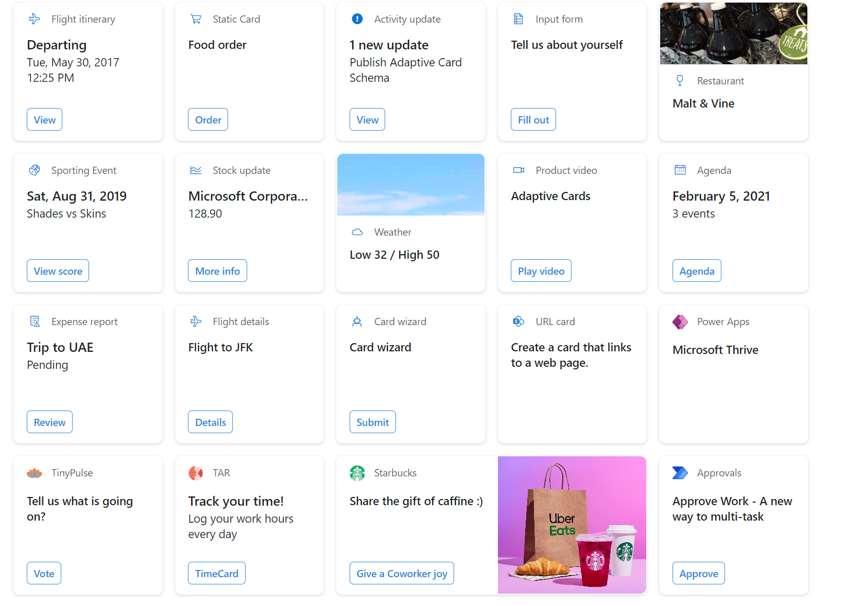
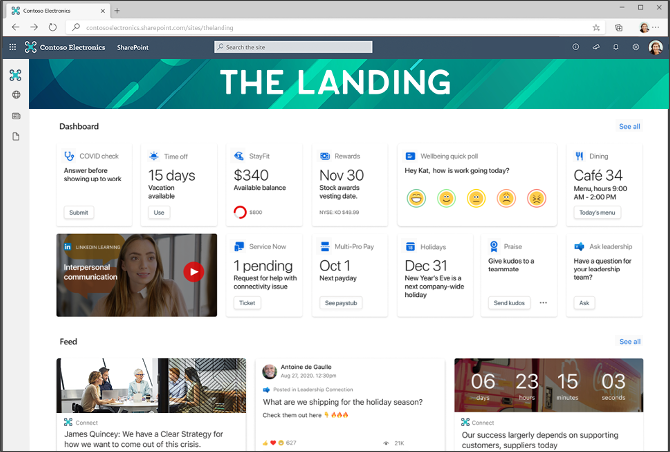
Viva Connections Dashboard

Slide 4
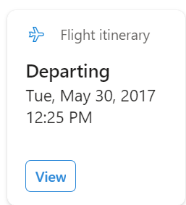
Cards, Quick Look and External View
A Card is the first experience you have in the dashboard
Provides a first glance of actionable information to end users
Required

Slide 5
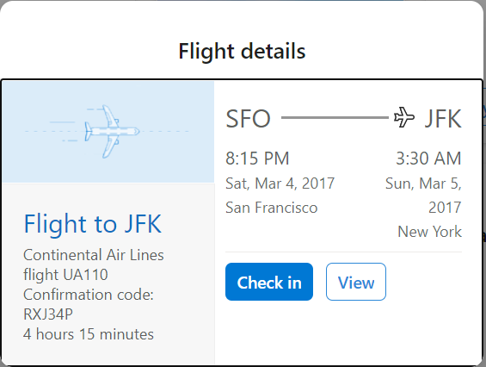
Cards, Quick Look and External View
A Quick Look is a UX experience that triggers from an action that happened in the card
Launched by clicking on a button or clicking on the card itself
Provides additional details or functionality within the dashboard experience
Optional

Slide 6
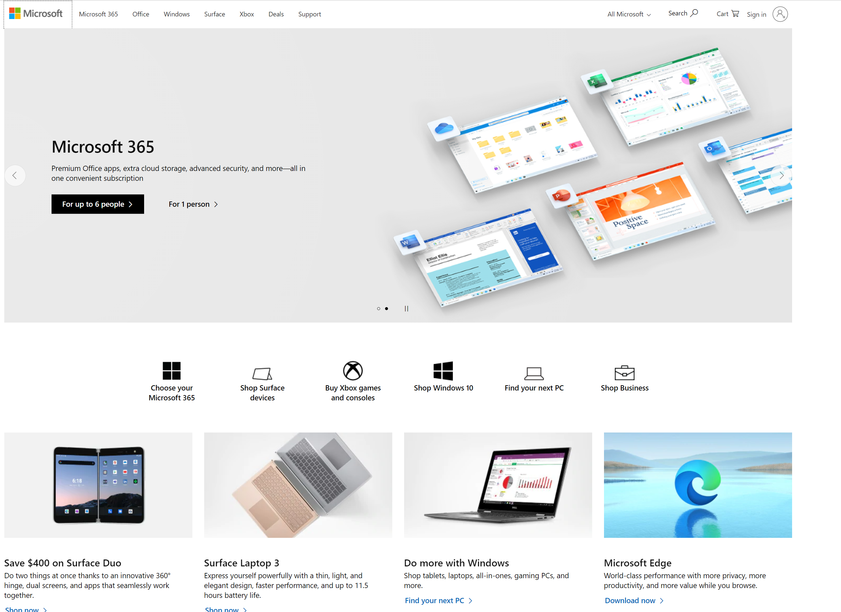
Cards, Quick Look and External View
External Views can be used to provide a full app experience
Triggered from a Card and/or Quick Look
Moves the user outside the dashboard context
Optional
Natively, we support 3 types of cards:
1st party Teams apps cards
1st party Pages cards
ACEs

Slide 7
Adaptive Card Extensions (ACEs)
New SPFx component type designed to express UX in a dashboard
Works both on dashboard as well as modern pages
Used by developers to build Cards and Quick Look experiences
It is SharePoint Framework: all the goodness provided by SPFx are there
Introduces a clear separation between UX and business logic:
UX is constrained: no full control of the DOM
Uses Adaptive Card framework components
That gives us the ability to render the ACE natively on supported clients

Slide 8
Viva Connections - Dashboard - Mobile

Slide 9
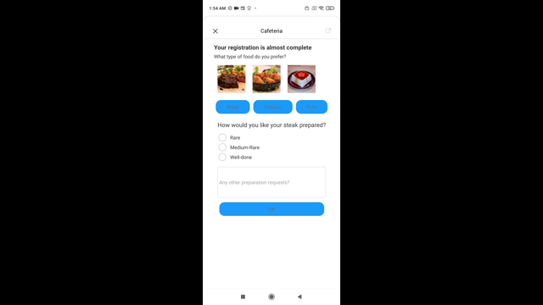

Slide 10
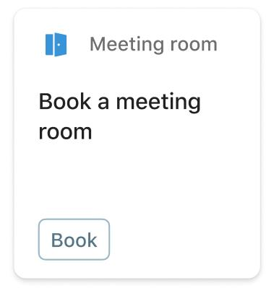
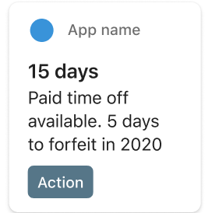
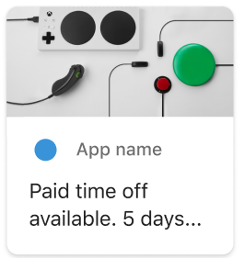
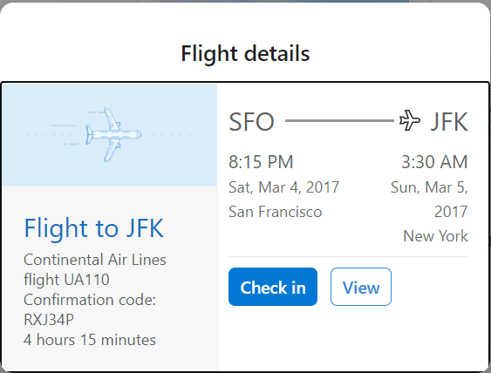
Anatomy of an ACE
View: describes the content of Card or Quick Look state
There are predefined templates developers can choose from.
This allows developers to focus on data model and lifecycle rather than the user interface
Card Views
Quick Look
BaseBasicCardView
BasePrimaryTextCardView
BaseImageCardView
BaseQuickLookView

Slide 11
Anatomy of an ACE
View: describes the content of Card or Quick Look state
There are predefined templates developers can choose from.
This allows developers to focus on data model and lifecycle rather than the user interface
Each template exposes different parts of the card that can be updated
Card Views
Quick Look
BaseBasicCardView
BasePrimaryTextCardView
BaseImageCardView
iconProperty
title
primaryText
imageUrl
description
get template()
BaseQuickLookView

Slide 12
Anatomy of an ACE
View: describes the content of Card or Quick Look state
There are predefined templates developers can choose from.
This allows developers to focus on data model and lifecycle rather than the user interface
Each template exposes different parts of the card that can be updated
State: represents parts of the app that can change
Developers can use setState() API to update the state for all views and trigger a re-render the desired view
Navigator: stores/manages views in a stack.
Current view that is to be displayed is determined by the card that is at the top of the stack
Cards and Quick Looks need to be registered before it is pushed to the navigator stack

